Slide 1
TLL311111 - USB-C to 3.5mm
jack audio cable, 1m
Presentation

Slide 2
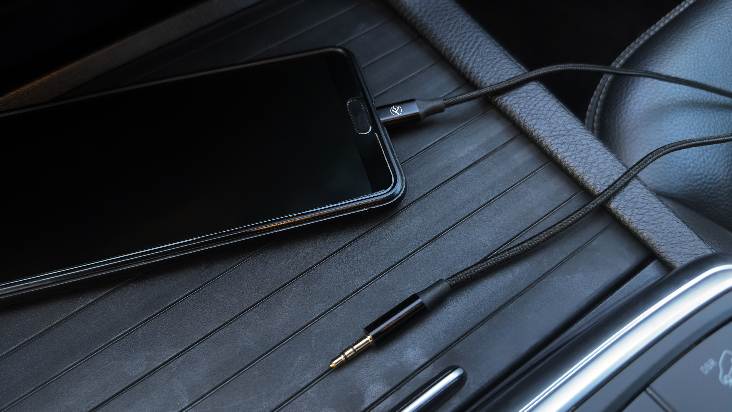
Premium Sound Quality!
Hi-Fi sound. DAC. Plug and Play.
This USB-C to 3.5mm aux cable can easily connect your USB- C devices to car stereo, home stereo, speaker, headphones or any device with standard 3.5mm audio jack

Slide 3
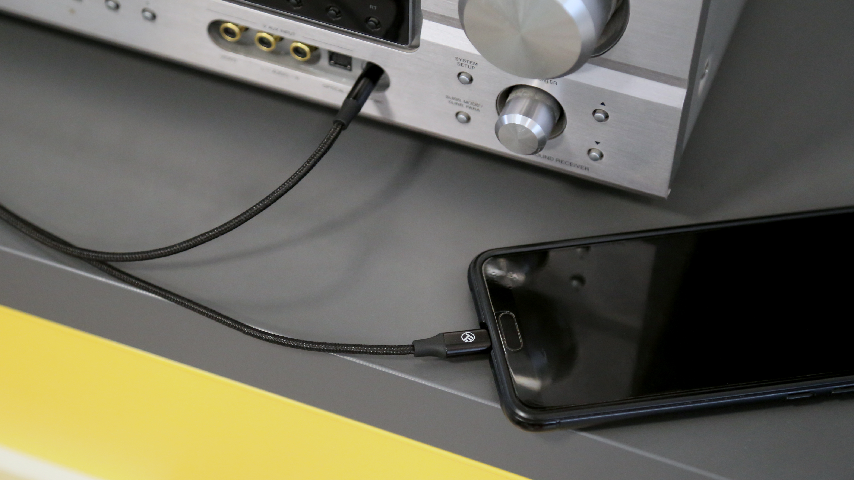
A built-in digital to analog converter ensures that you always get high-resolution audio
A nylon jacket surrounds the cord for increased durability

Slide 4
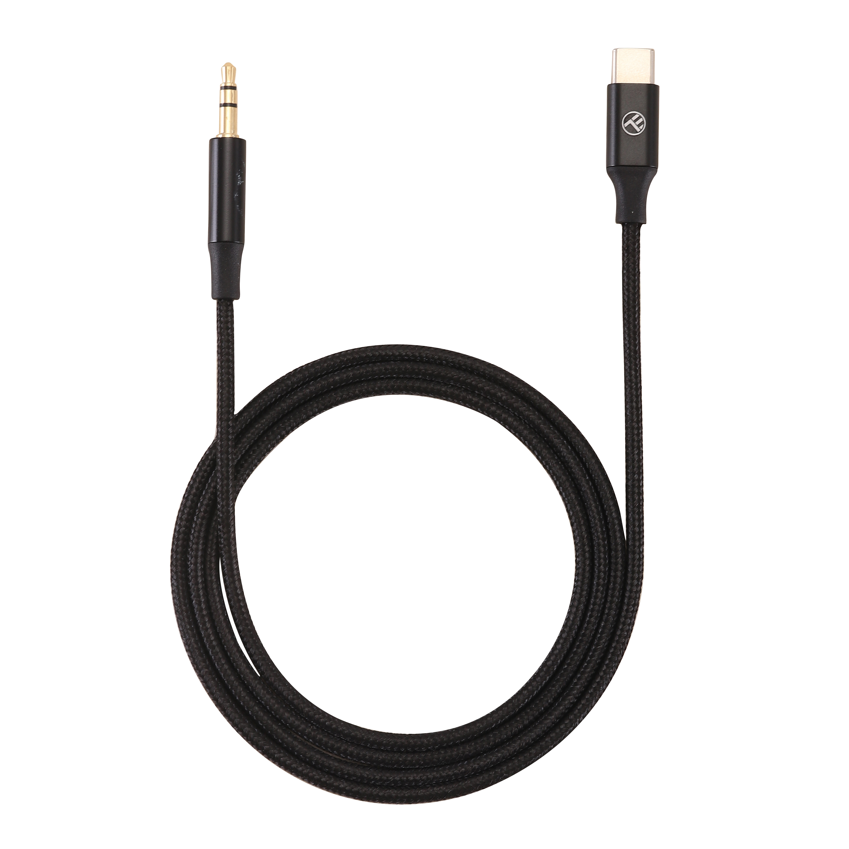
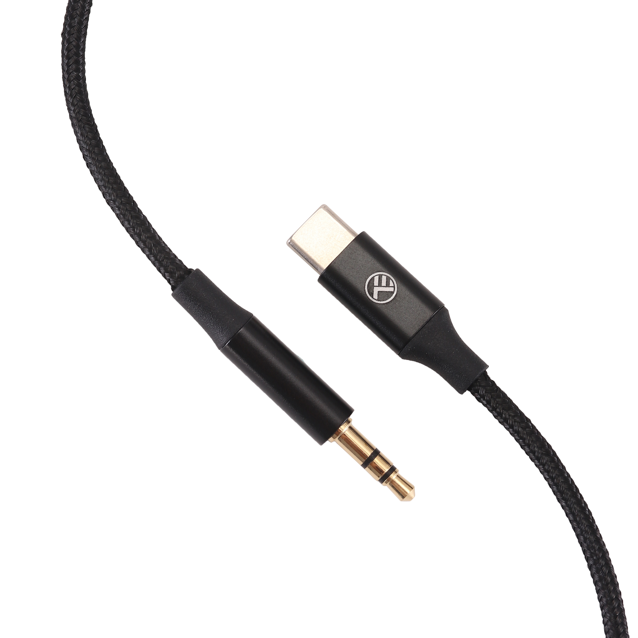
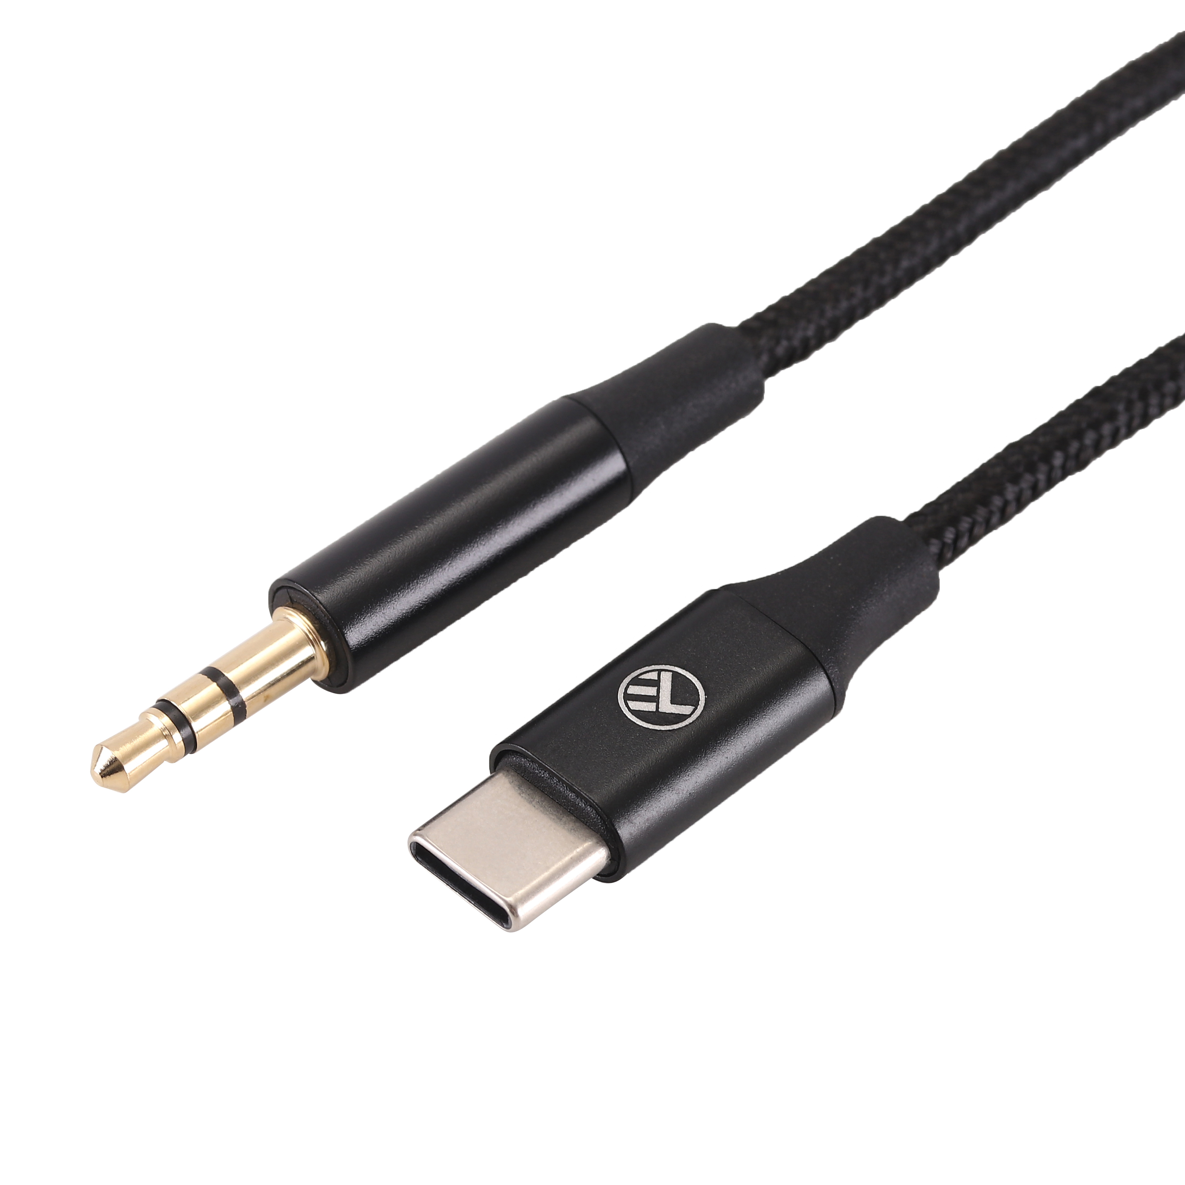
Technical specs
Connector type: | USB-C, Jack 3.5mm (male)
Features: | Built-in DAC chip
Length: | 1m
Material: | Nylon
Compatible with: | Car stereo, home stereo, speaker, headphones with AUX input jack
Available colors: | Black
Product weight: | 15g
Package includes: | 1 x USB-C to 3.5mm audio cable, 1 x Manual
Product code: | TLL311111
EAN: | 5949120004855

Slide 5
THANK YOU!
For more products, please visit : https://www.tellur.com

